Slide 1
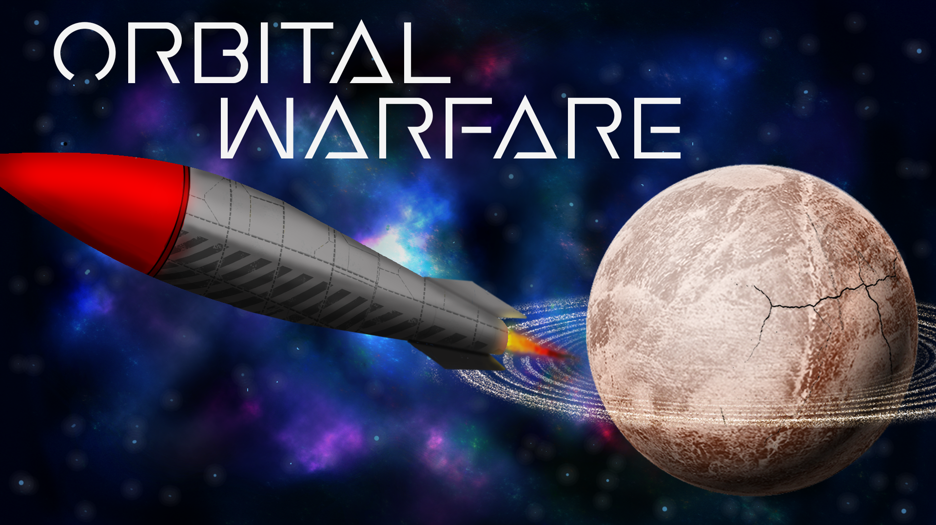
Liam Bakker
Tymon Simonides
Daniel Tarsoly
Martins Avots
Larissa Hartmann

Slide 2

Orbital Warfare is a physics-based game where you and an other ‘Captains‘ fight against each other in space!
Genre: Physics-based, action Target audience: 12+

Slide 3
The world is set in a zoomed out spacefield.

Slide 4
Two player deathmatch
Players are Spaceships
Players win by destroying the other player off the arena
Player can use power-ups and also destroy the enviroment planets to triumph over the opponent.

Slide 6
Thank you for your attention!
Any
Questions?

Slide 7
Now The boring stuff

Slide 8
Content
Game Elements
Moodboard
Stylesheet
Concept Art
Mockup
Flwchart
Planning
Prototype Game

Slide 9
Game Elements
Theme: Spaceships fighting against each other
Essences: Shooting in space
Collecting money to upgrade your ship
Destruction
Conflicts: Man vs. Man

Slide 10
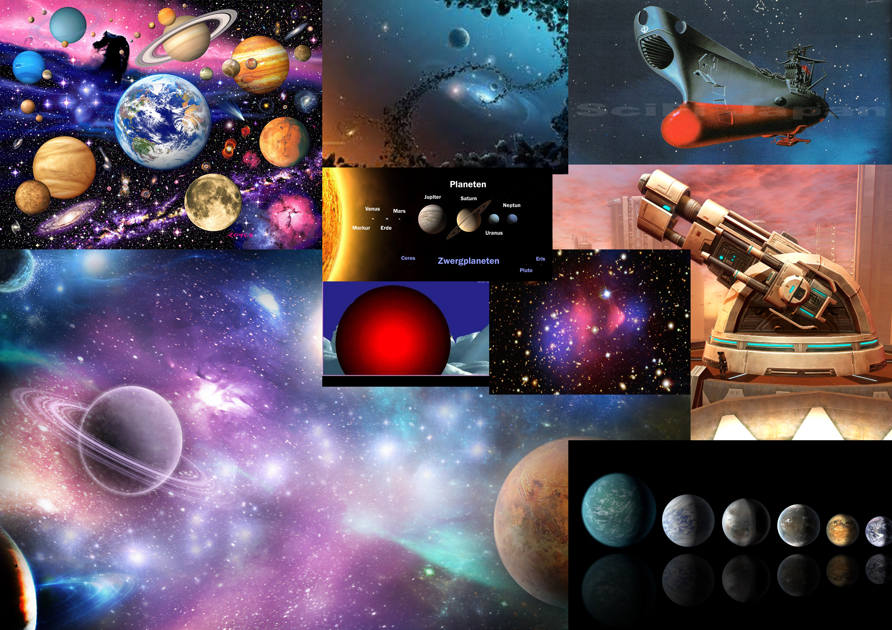
Moodboard

Slide 11
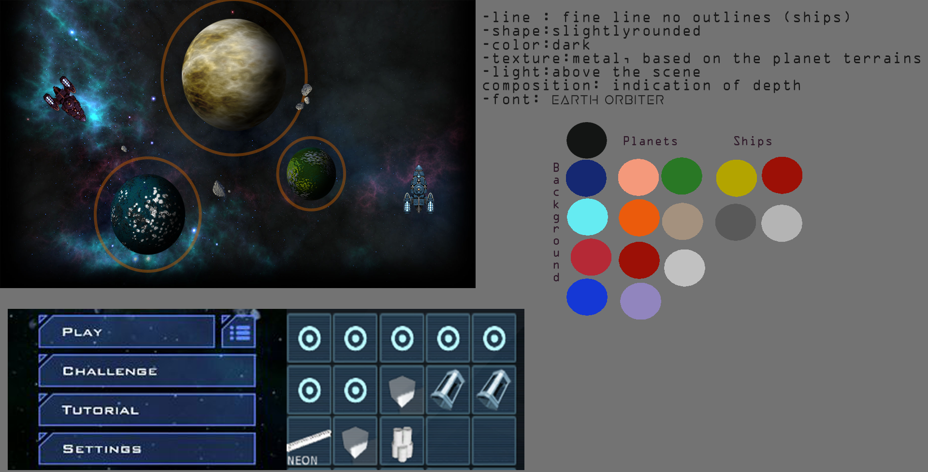
Stylesheet

Slide 12
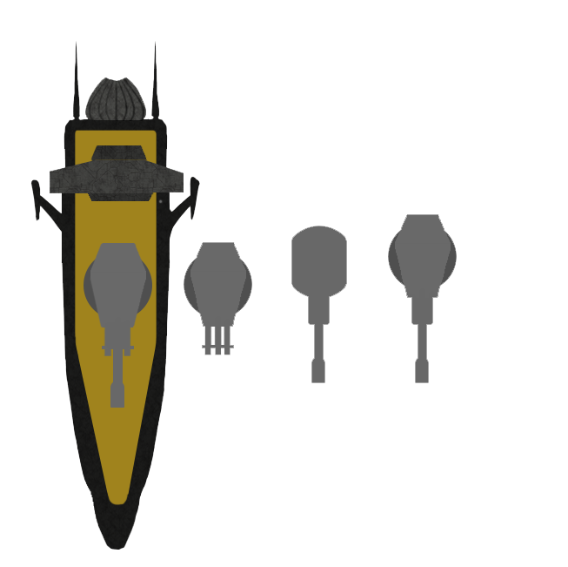

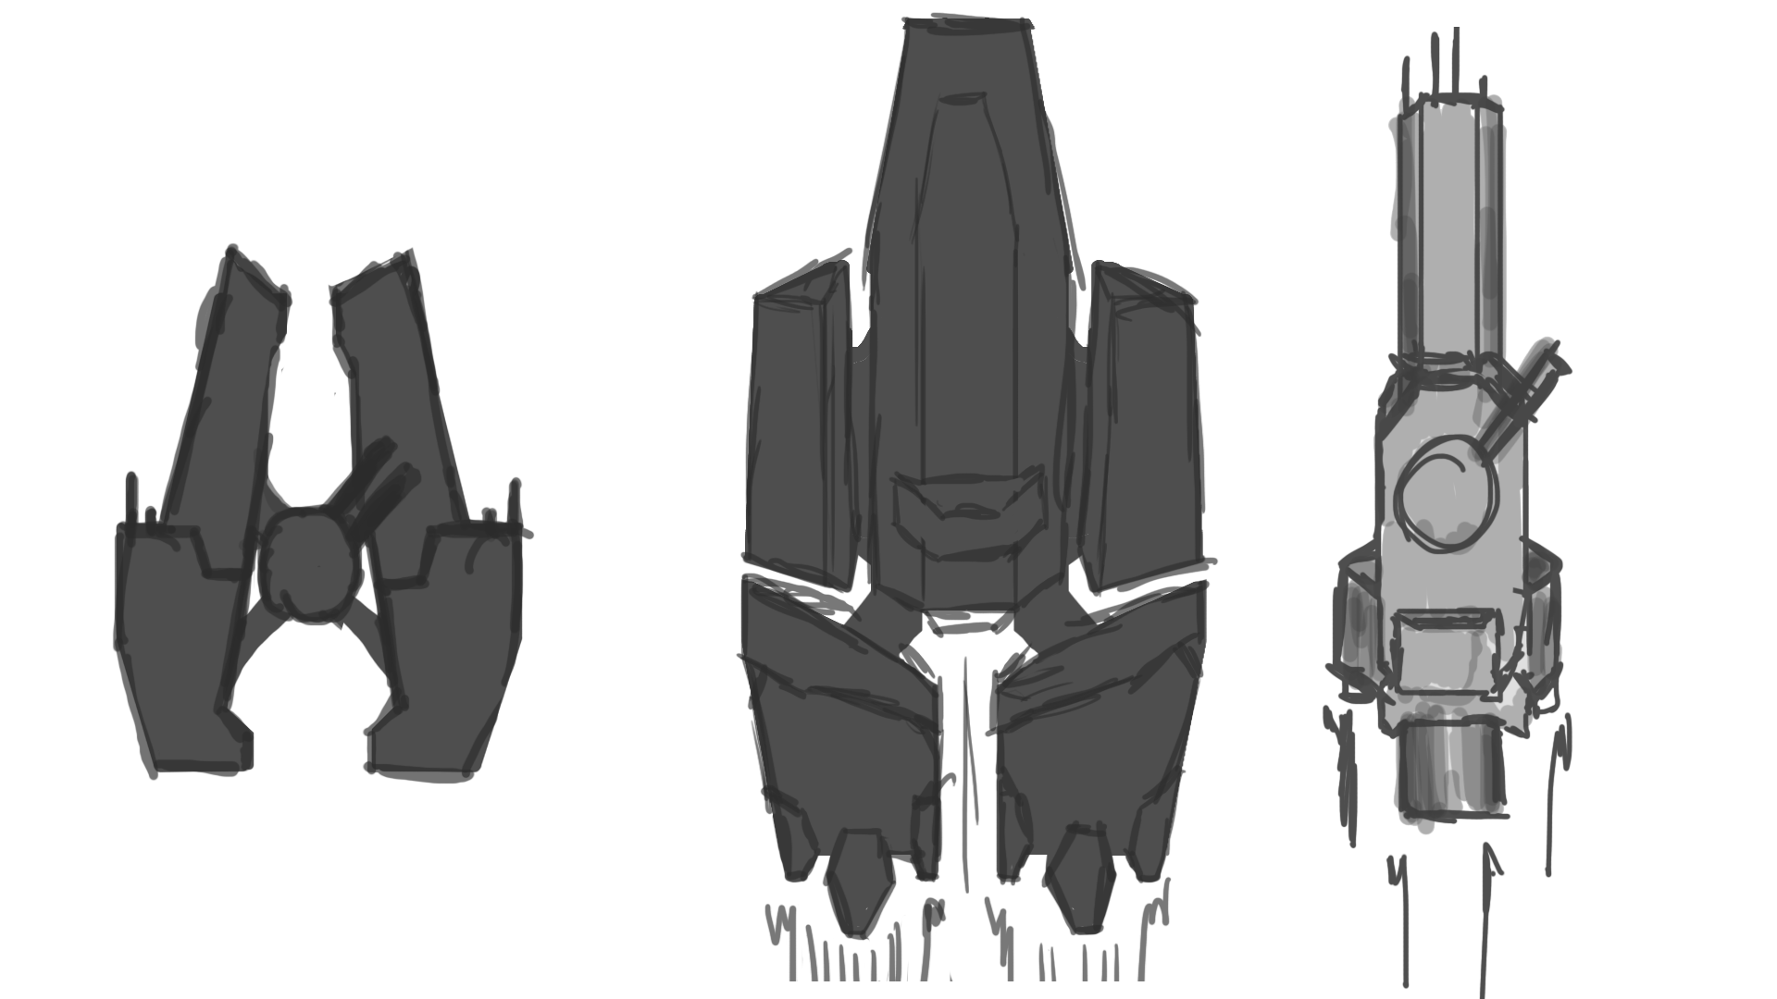
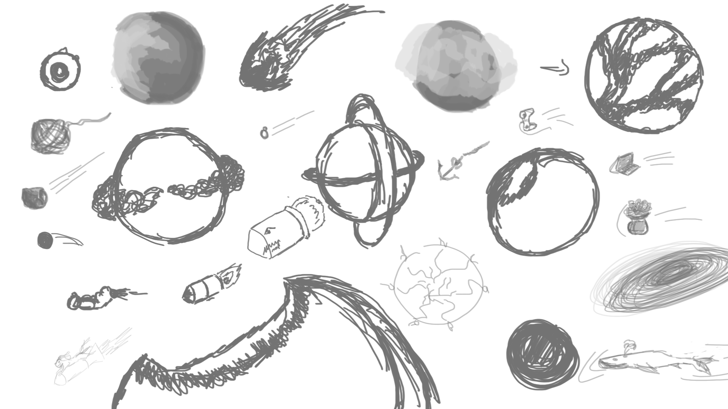
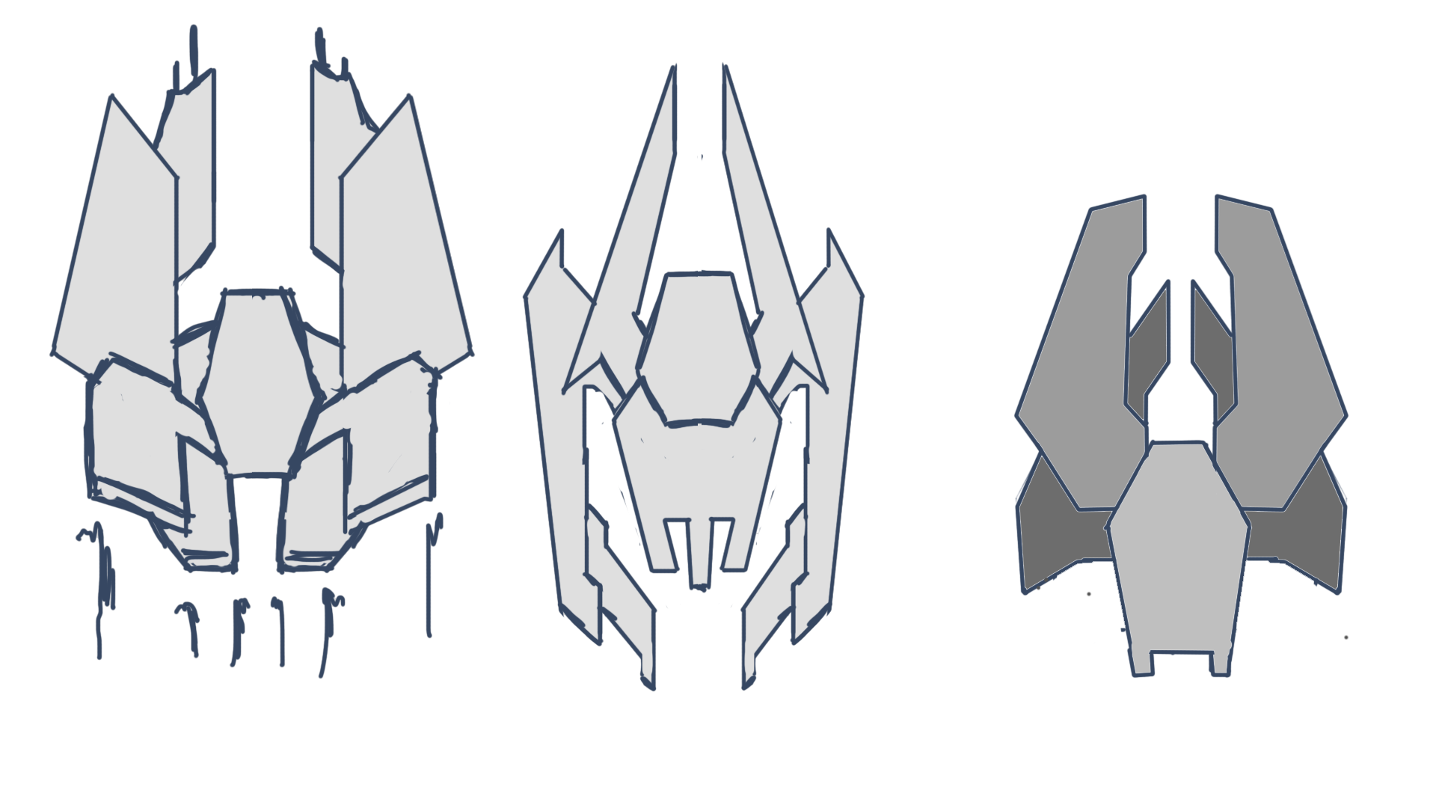
Concept

Slide 13

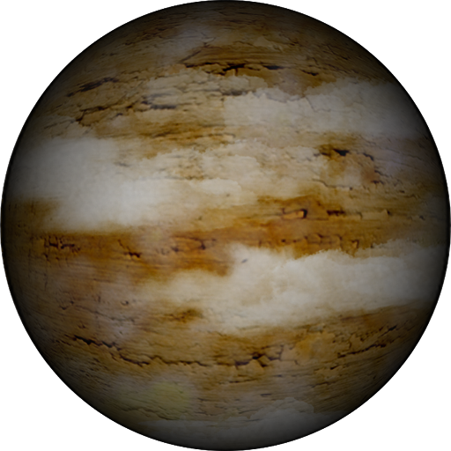
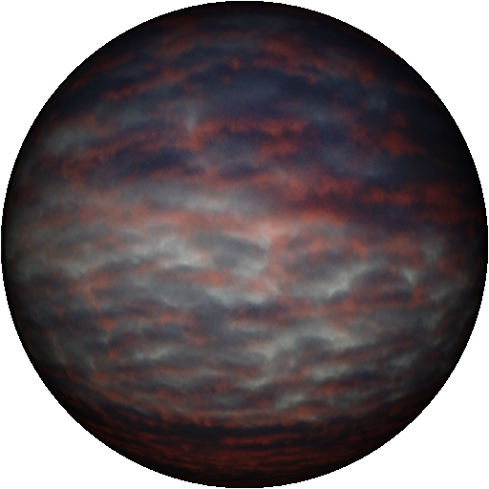

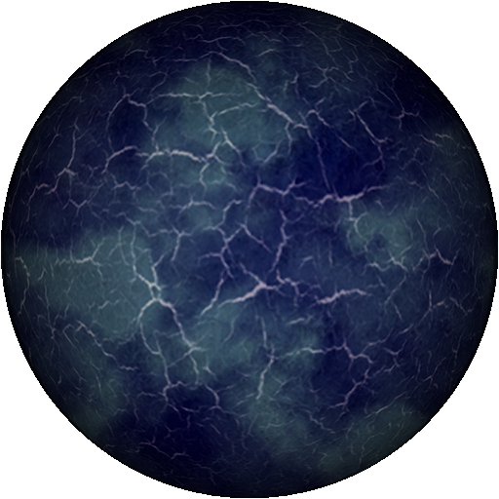
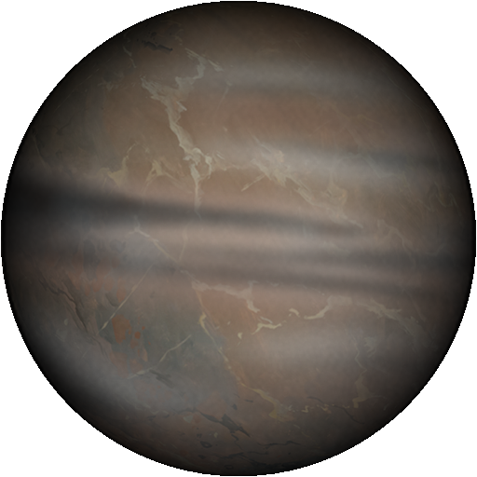
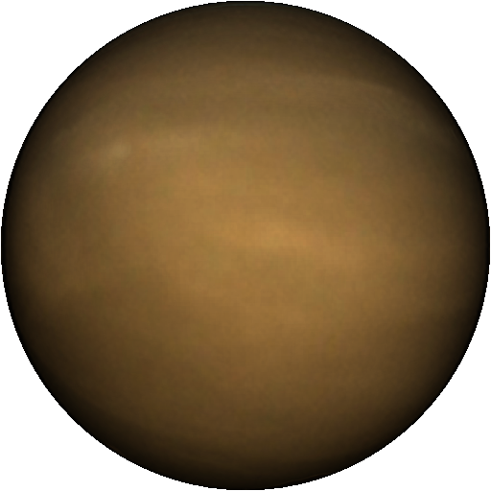


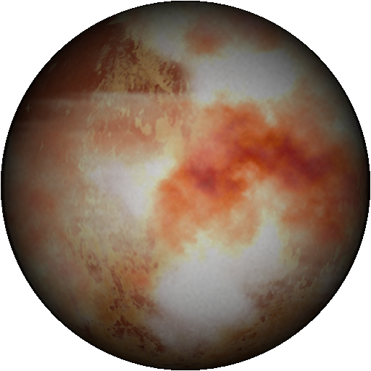
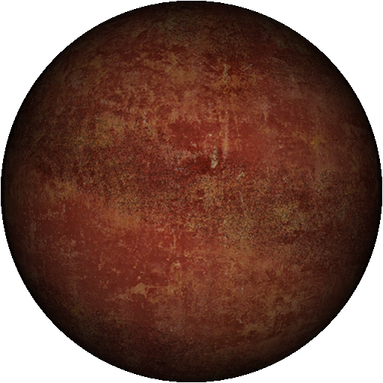
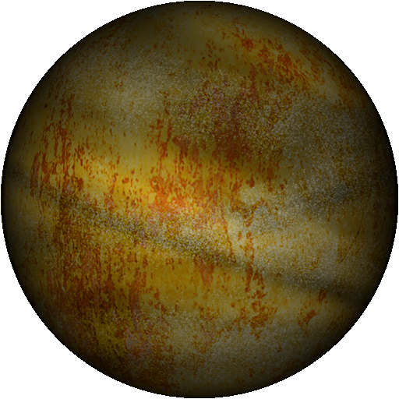
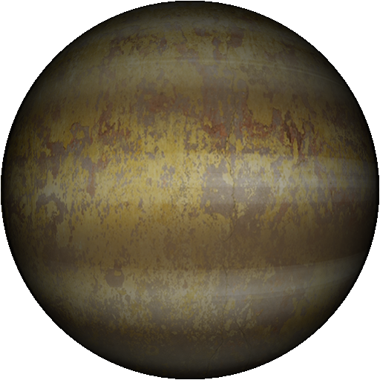
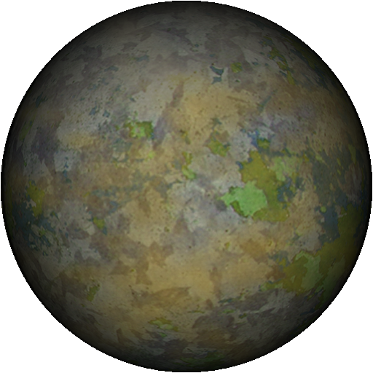
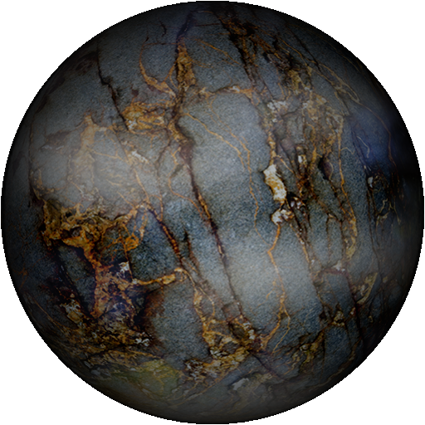
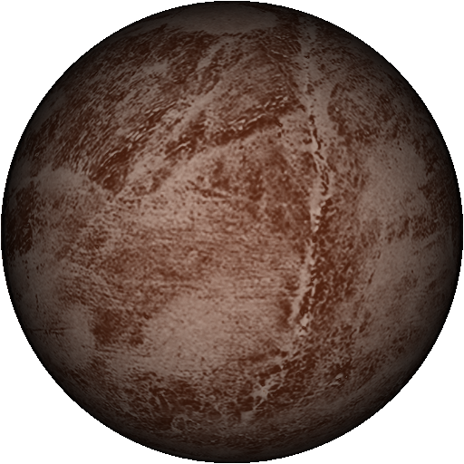
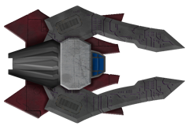

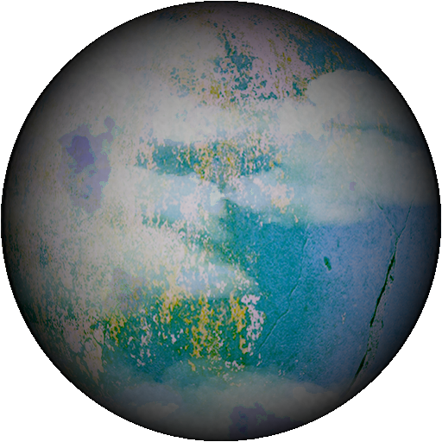
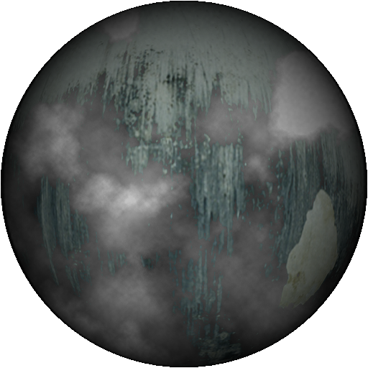
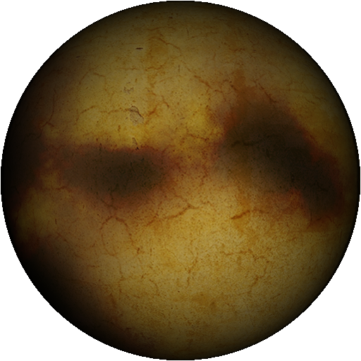
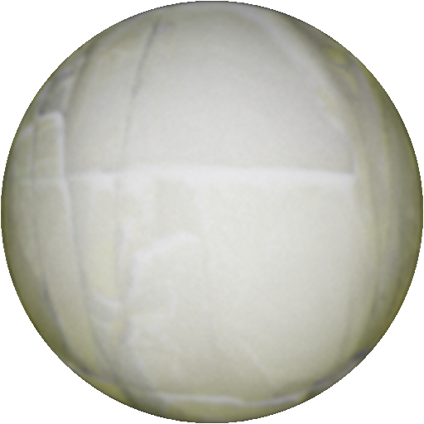

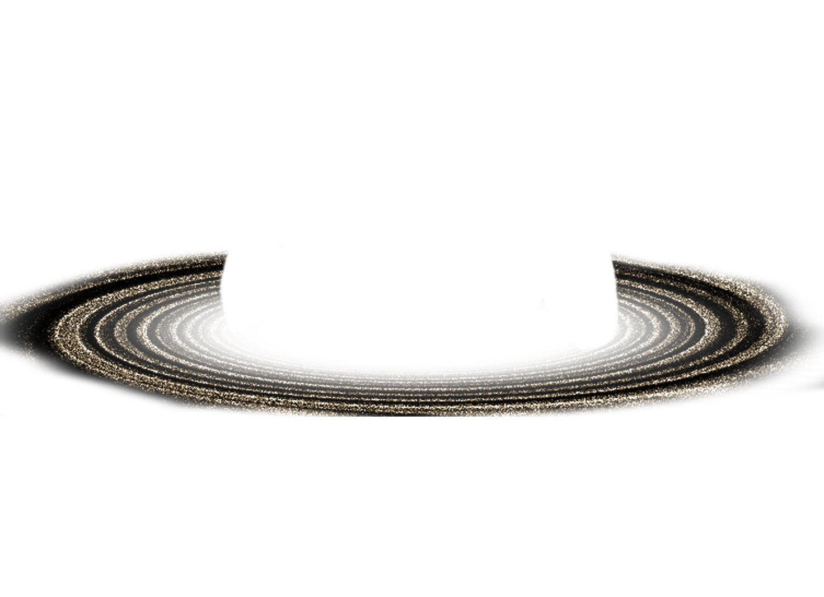

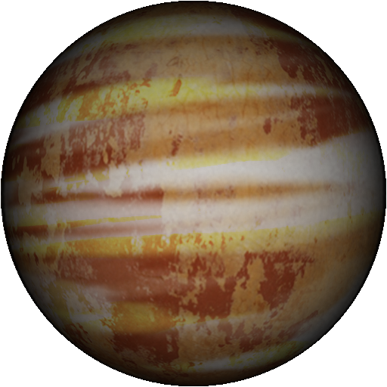
Concept

Slide 14
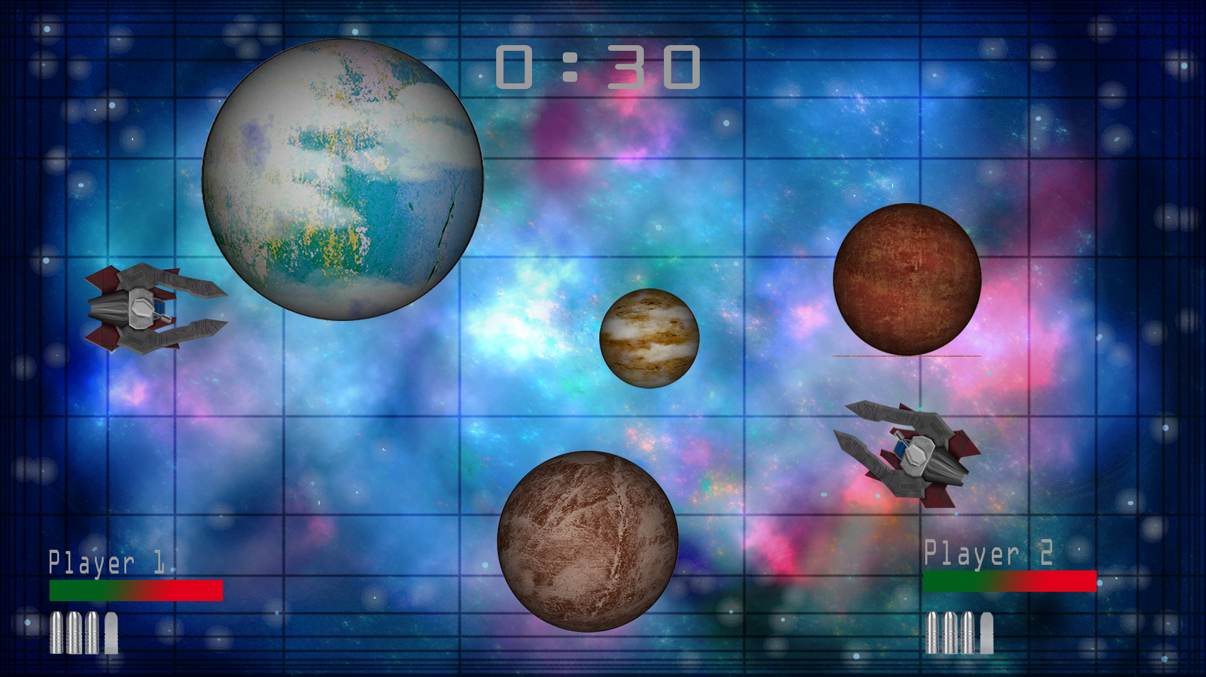
Mockup

Slide 15
Flowchart

Slide 16
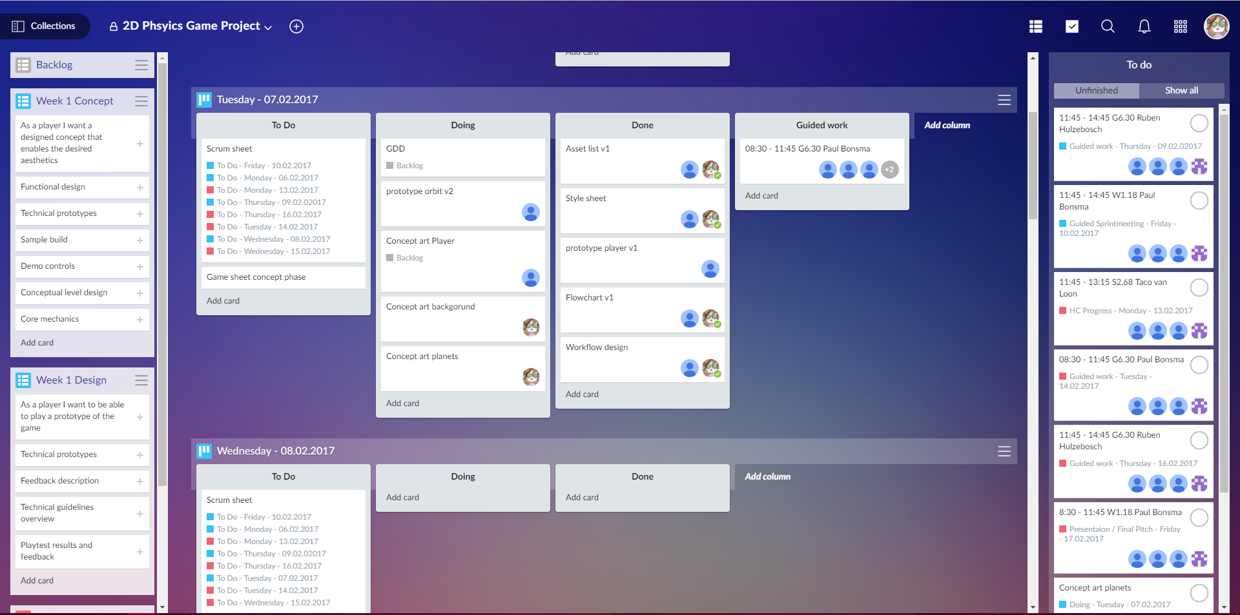
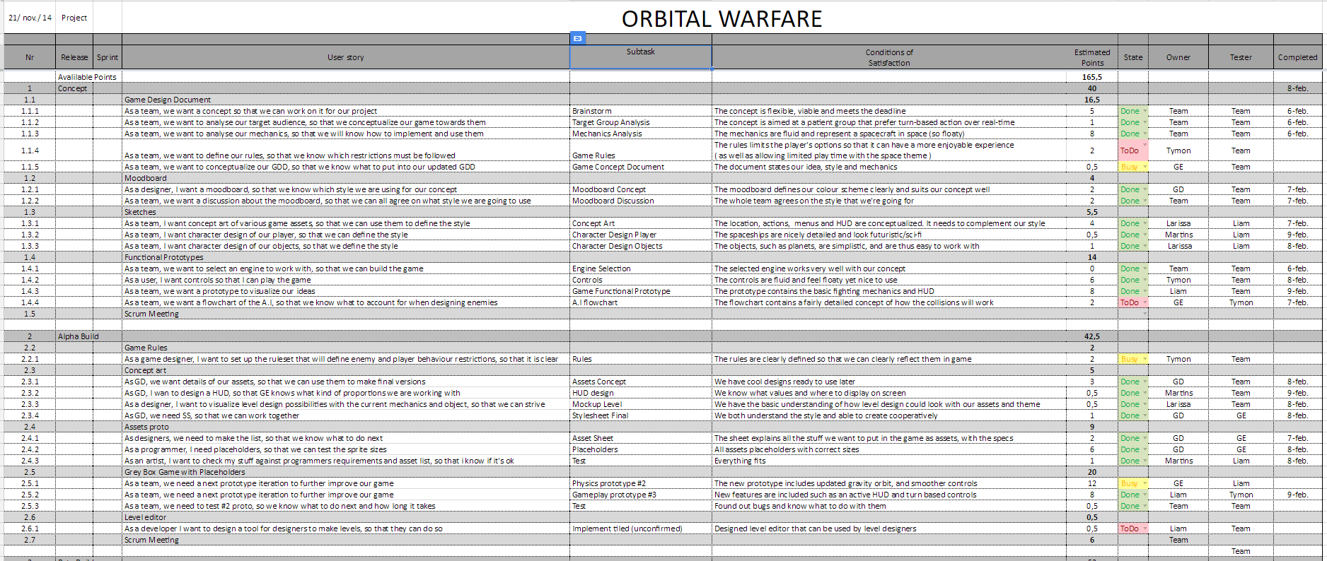
Planning

Slide 17
Thank you for your attention!
Any
Questions?

